Slide 1



call center
View in Power BI
Last data refresh:
9/4/2021 10:31:46 PM UTC
Downloaded at:
3/31/2022 7:22:02 PM UTC

Slide 2
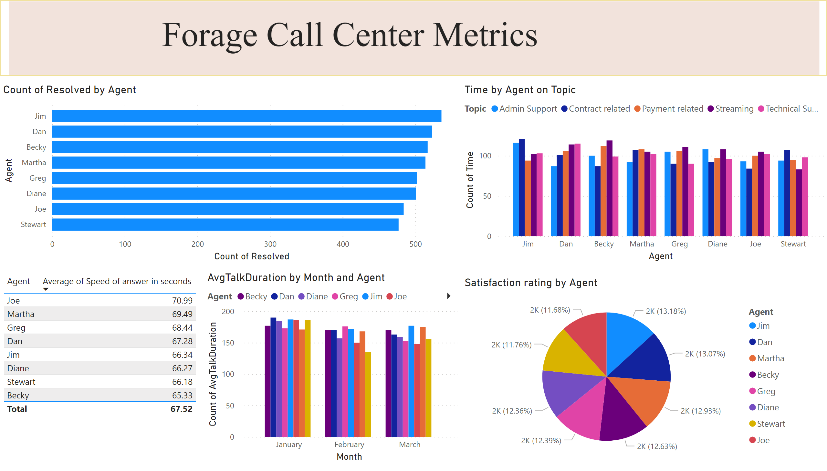
Page 1
Notes:
basicShape
No alt text provided
textbox
No alt text provided
AvgTalkDuration by Month and Agent
No alt text provided
clusteredBarChart
No alt text provided
Time by Agent on Topic
No alt text provided
tableEx
No alt text provided
pieChart
No alt text provided

